Slide 1

Spring webflux
Prem Ranjan Shankar

Slide 2
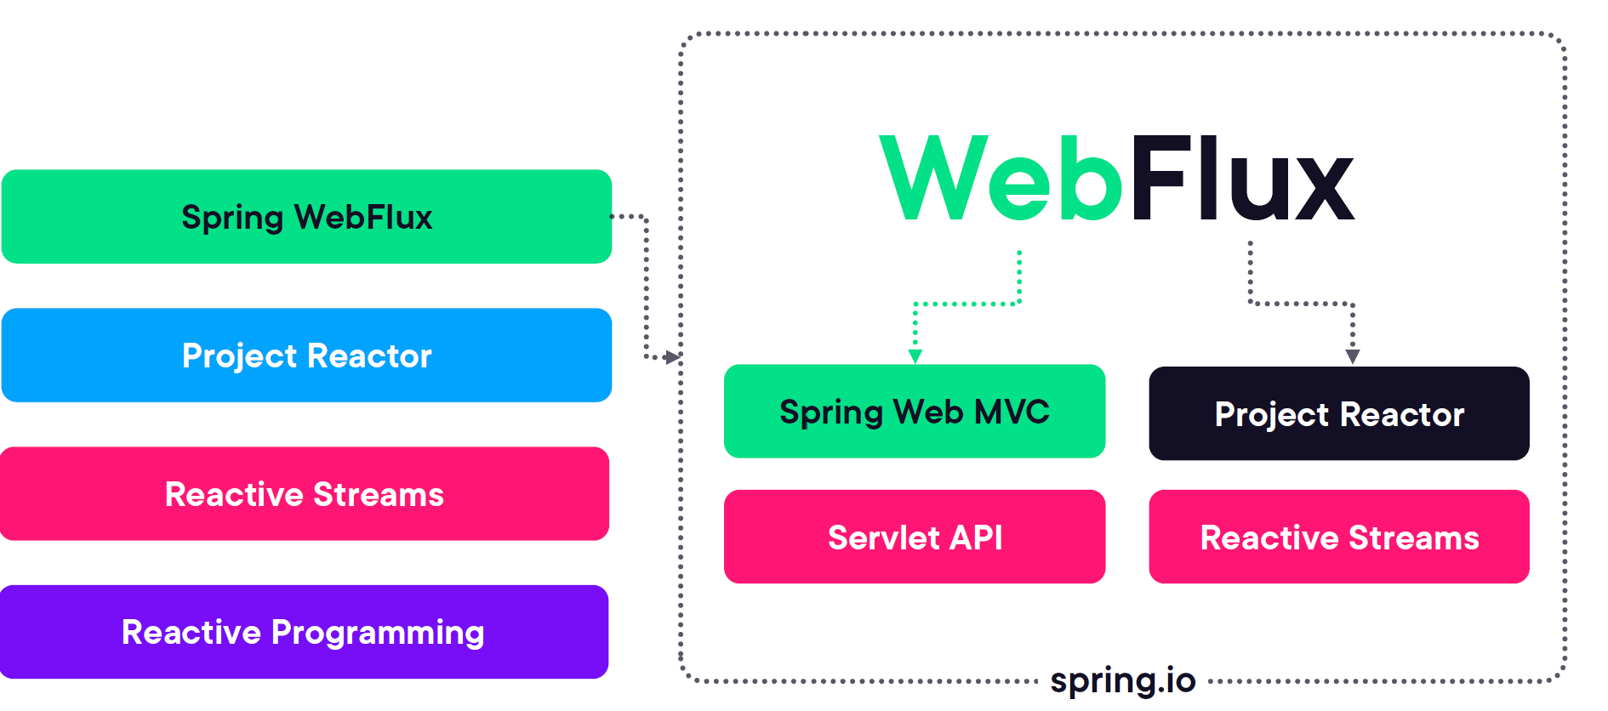
Spring WebFlux
Project Loom

Slide 3
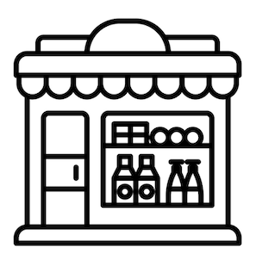


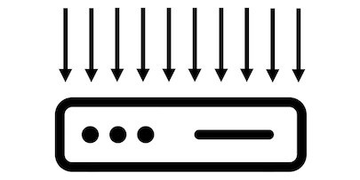
The Problem with Blocking
Imagine you’re the manager at a successful grocery store.
Suddenly, the number of people standing in the checkout lines starts to increase.
Probably the obvious choice is to open more checkout lanes (assuming there are more lanes or cashiers available).
The server maintains a pool of threads to serve requests. If the pool size is 10, it means the server can handle 10 requests concurrently.

Slide 4
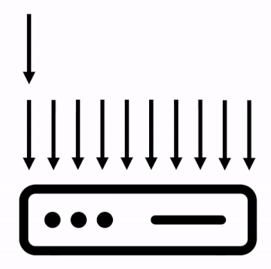
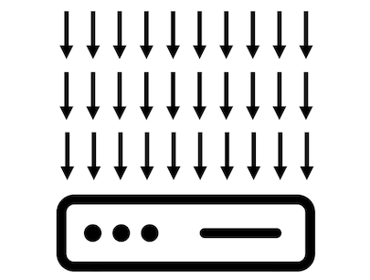
The Problem with Blocking
The eleventh request will have to wait until the server finishes processing one of the first ten requests.
In other words, the execution is blocked until a free thread can process the request.
Now imagine that our ten threads have to handle thirty requests.
Probably the obvious choice is to open more checkout lanes (assuming there are more lanes or cashiers available).
The server maintains a pool of threads to serve requests. If the pool size is 10, it means the server can handle 10 requests concurrently.

Slide 5
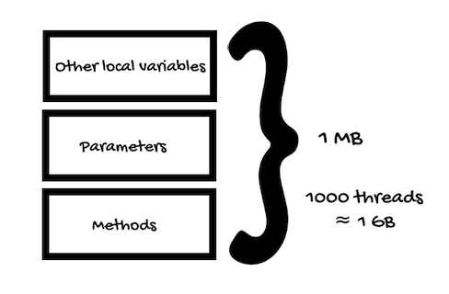
Design/Architecture Consideration
The time it takes the server to process the request, the response time for the user, will increase.
Opening more checkouts in a grocery store would be the equivalent of adding more resources to our application. Resources such as threads, CPUs, servers, or containers.
But is adding more resources the best approach?
What if the number of concurrent users keeps increasing until there are no more free threads?
Roughly speaking, at any given time, one CPU core can handle one thread (multithreading is just the CPU switching execution between threads.
Memory Utilization

Slide 6
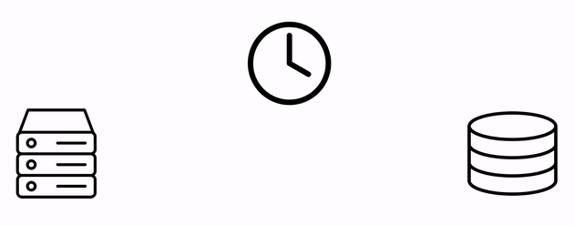
Design/Architecture Consideration
So, when talking about platform threads (traditional, not virtual threads), this blocking approach can result in inefficient use of memory and CPU.
The second thing to consider is the time the server takes to communicate with a database or another system, for example.
Just like in a grocery store where people can take ages at checkout looking for their wallet or arguing about prices, your application might run into a query that takes too long to return information from the database.
If the program does nothing while waiting for the data, it’s a waste of resources.
However, if you allow more requests to an already overloaded database, for example, the problem will only get worse.

Slide 7
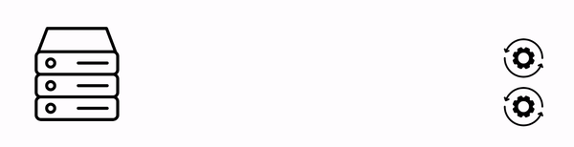
Design/Architecture Alternatives
The alternative is to make more efficient use of the resources.
What if instead of waiting for the data, our program could switch to another task, coming back later to the other request when the data is available?
The reactive paradigm allows us to do that.

Slide 8
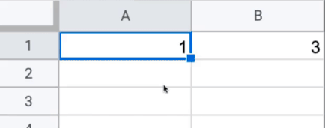
Reactive programming
The word “Reactive” comes from the verb “react”. Here are two definitions that the dictionary provides for this word:
To act in response to an agent or influence.
To respond to a stimulus in a particular manner.
Okay, so reactive programming is about responding to something.
Reactive programming is often compared to “programming a spreadsheet,” where you set up values and relationships for those values.
For example, I can define cell B1 as the value of cell A1 plus two.
This way, every time I change the value of cell A1, the other cell reacts to that change.

Slide 9
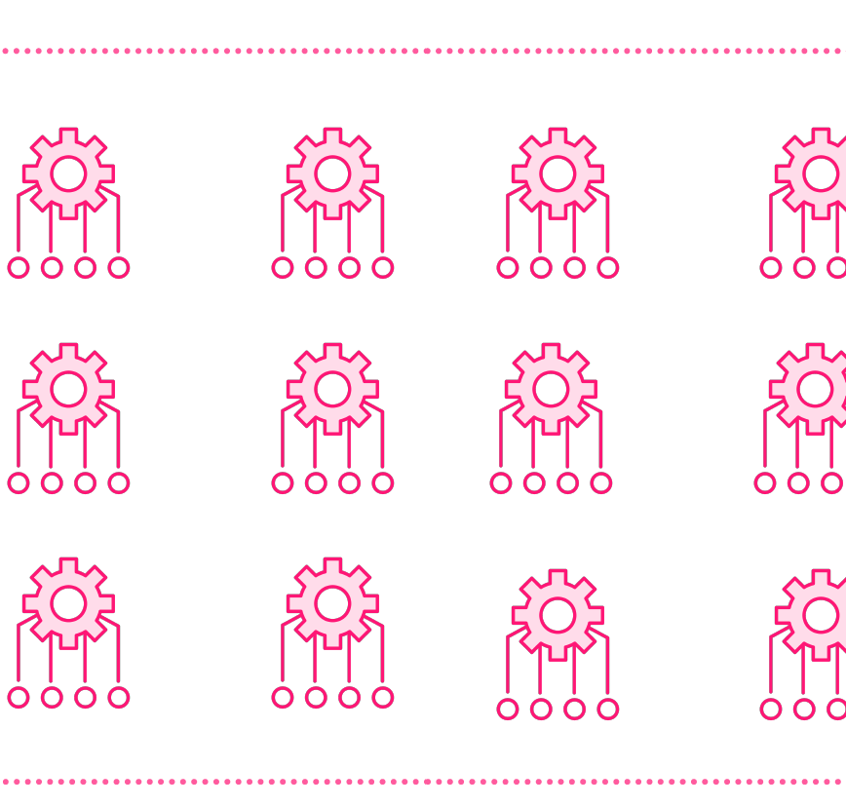
Project loom

Slide 10
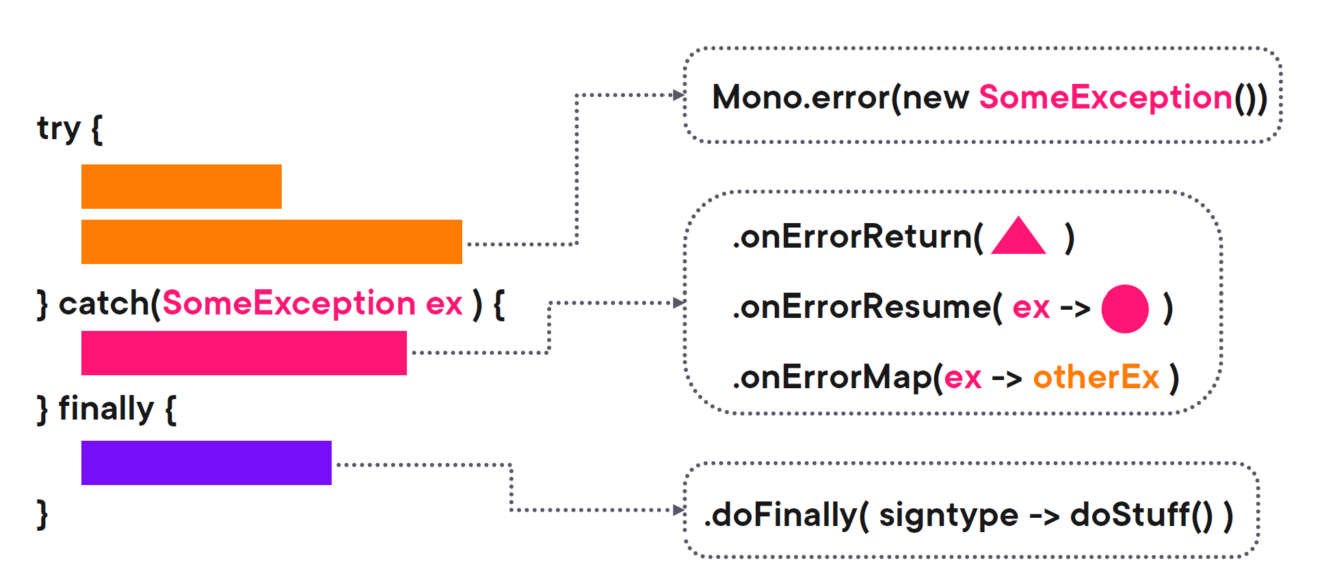
Error handling

Slide 11

Thank you

